Slide 1
LABOUR MANAGEMENT SYSTEM
STUDENT DETAILS
Harshit Dutt Tyagi
2018825
MENTOR NAME
Dr. Surendra Kumar Shukla

Slide 2

LABOUR MANAGEMENT SYSTEM
MENTOR NAME
Dr. Surendra Kumar Shukla
STUDENT DETAILS
Harshit Dutt Tyagi
2018825

Slide 3
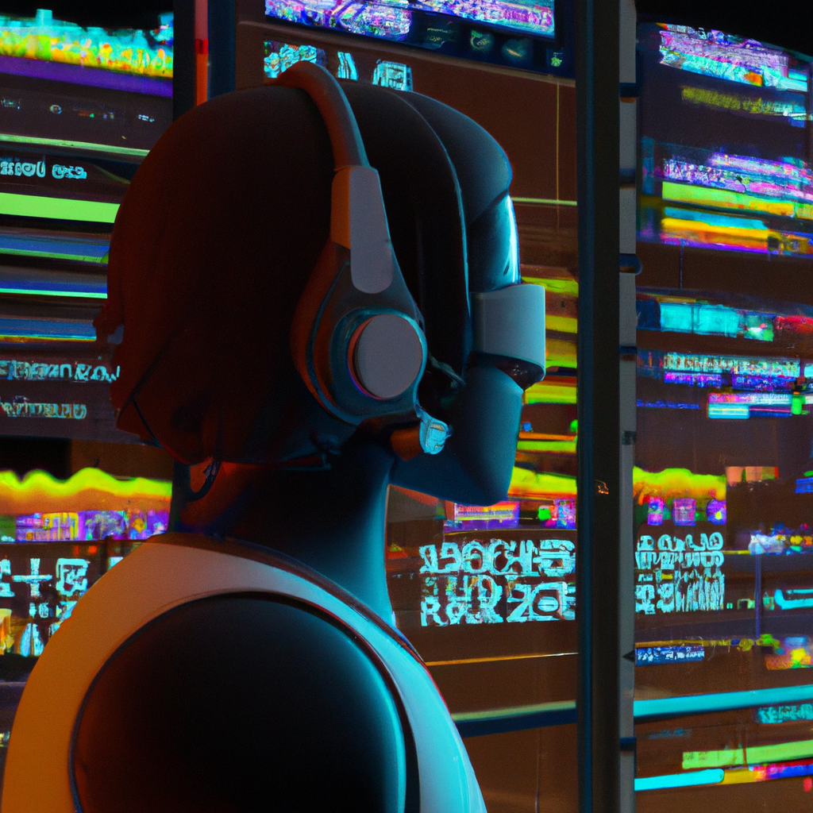
INTRODUCTION
Labour management systems are tools used to manage employee data and automate processes related to payroll, time tracking, and labour costs. They are used to streamline the hiring, scheduling, and payroll processes, as well as to track persons performance and attendance.
Labour management systems are becoming increasingly popular as they provide employers with the ability to effectively manage their workforce. They can help to reduce labour costs, improve employee engagement, and increase productivity.

Slide 4
INTRODUCTION
Labour management systems is a software used to manage employee data and automate processes related to payroll, time tracking, and labour costs. They are used to streamline the hiring, scheduling, and payroll processes, as well as to track persons performance and attendance.
Labour management systems are becoming increasingly popular as they provide employers with the ability to effectively manage their workforce. They can help to reduce labour costs, improve employee engagement, and increase productivity.

Slide 5
PROBLEM STATEMENT
To manage the work force information in an organization with the help of a software so that it easy to maintain data of labours in an organization and what are the benefits they are receiving from the organization .

Slide 6
PROBLEM STATEMENT
To manage the work force information in an organization with the help of a software so that it easy to maintain data of labours in an organization and what are the benefits they are receiving from the organization .

Slide 7
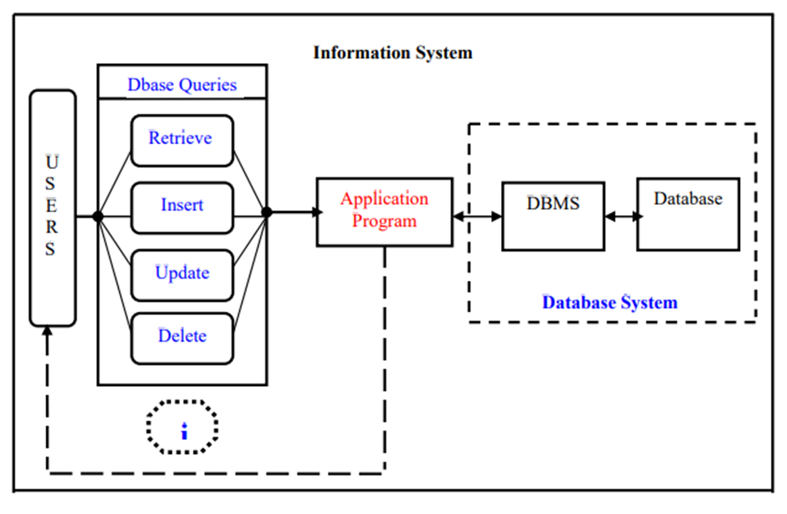
METHODOLOGY
Firstly, I used Python Tkinter to make my project so that I can give a little GUI in my project for good user experience.
Then I imported necessary libraries required in this project like ttk, messagebox, Database, Image Tk.
After that I connected my database to main program and created the required field variables.
Created a global root variable to call all the functions present in tkinter.
All the field variables were declared in respective datatypes.
Designed an entry frame and labels to enter the value of variables.
Then , I gave defination of functions getData(), displayAll(), add_labourdetails(), update_labourdetails, delete_labourdetails and ClearAll().
Then I made button frame to perform operations like add, delete, update, clear.

Slide 8
METHODOLOGY
Firstly, I used Python Tkinter to make my project so that I can give a little GUI in my project for good user experience.
Then I imported necessary libraries required in this project like ttk, messagebox, Database, Image Tk.
After that I connected my database to main program and created the required field variables.
Created a global root variable to call all the functions present in tkinter.
All the field variables were declared in respective datatypes.
Designed an entry frame and labels to enter the value of variables.
Then , I gave defination of functions getData(), displayAll(), add_labourdetails(), update_labourdetails, delete_labourdetails and ClearAll().
Then I made button frame to perform operations like add, delete, update, clear.

Slide 9

METHODOLOGY
Then I made a tree frame for table to represent data with all the required fields also I added the vertical and horizontal scrollbar to view data if it is not fit in the screen.
An object is created of treeview ‘tv’ to make heading and columns of required fields and at last I call displayAll() function to display all the details.
Then In my ‘db.py’ I firstly, impoted sqlite3 and the create a database class and give the query to create a table with the required fields.
After that I created a function insert() to insert all data in the database which has received all values from ’main.py’.
Similarly, fetch, remove, update, functions to perform all the operations on the database.

Slide 10
METHODOLOGY
Then I made a tree frame for table to represent data with all the required fields also I added the vertical and horizontal scrollbar to view data if it is not fit in the screen.
An object is created of treeview ‘tv’ to make heading and columns of required fields and at last I call displayAll() function to display all the details.
Then In my ‘db.py’ I firstly, imported sqlite3 and the create a database class and give the query to create a table with the required fields.
After that I created a function insert() to insert all data in the database which has received all values from ’main.py’.
Similarly, fetch, remove, update, functions to perform all the operations on the database.

Slide 11
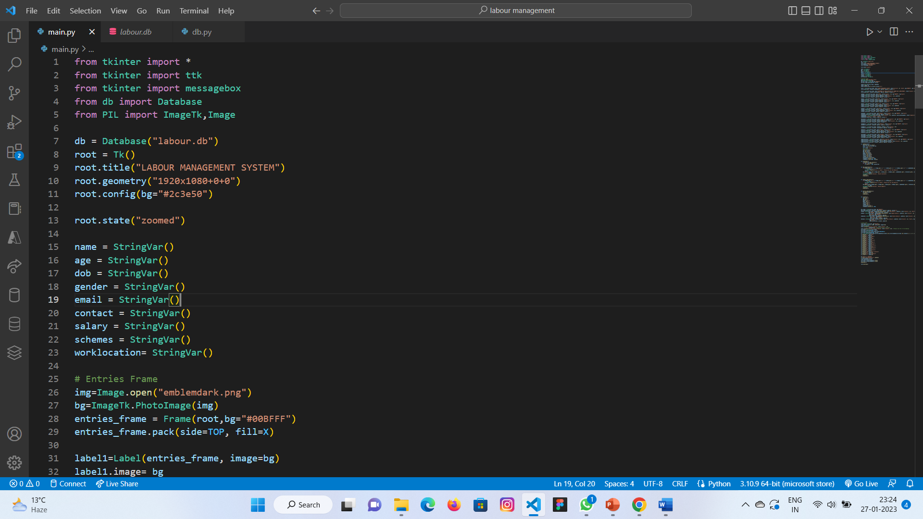
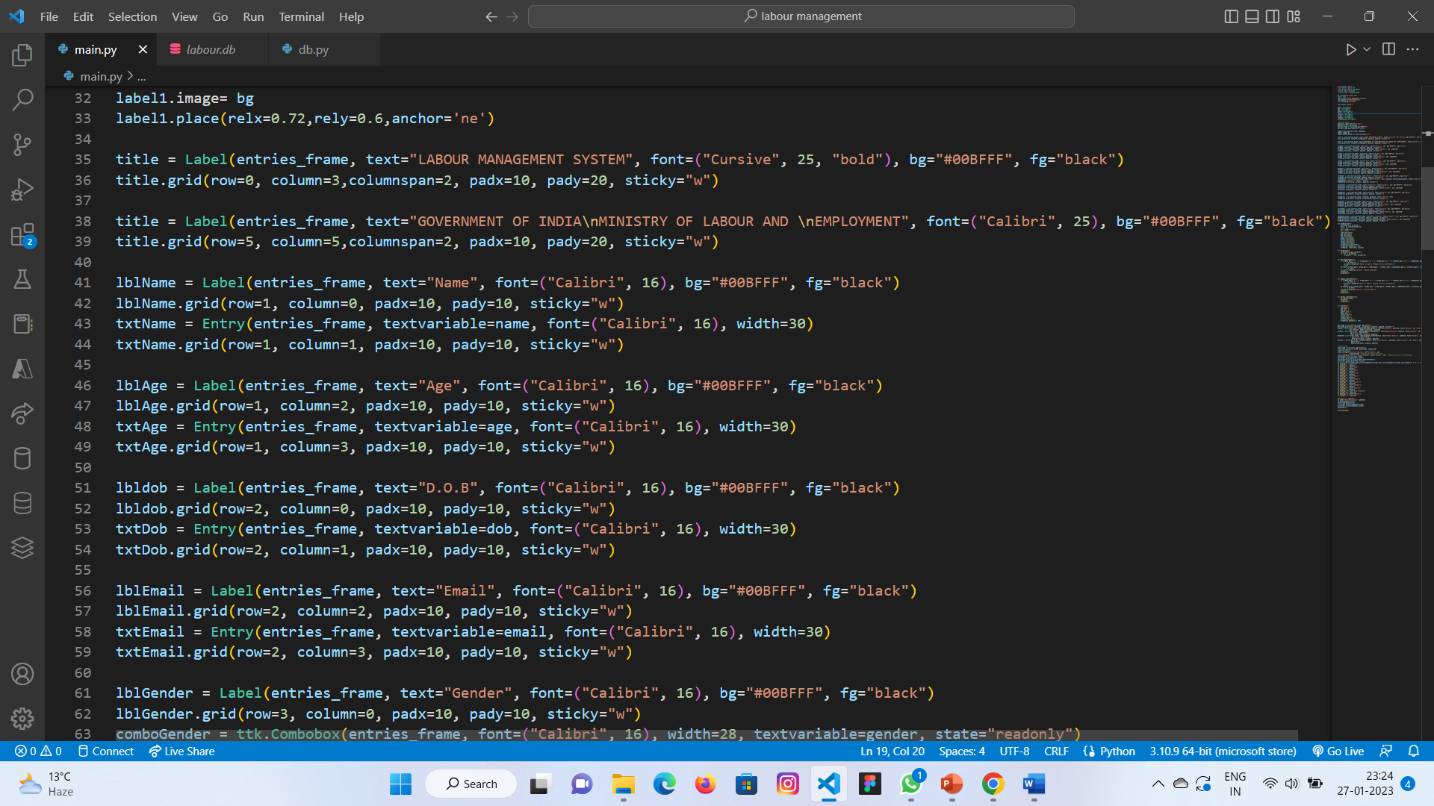
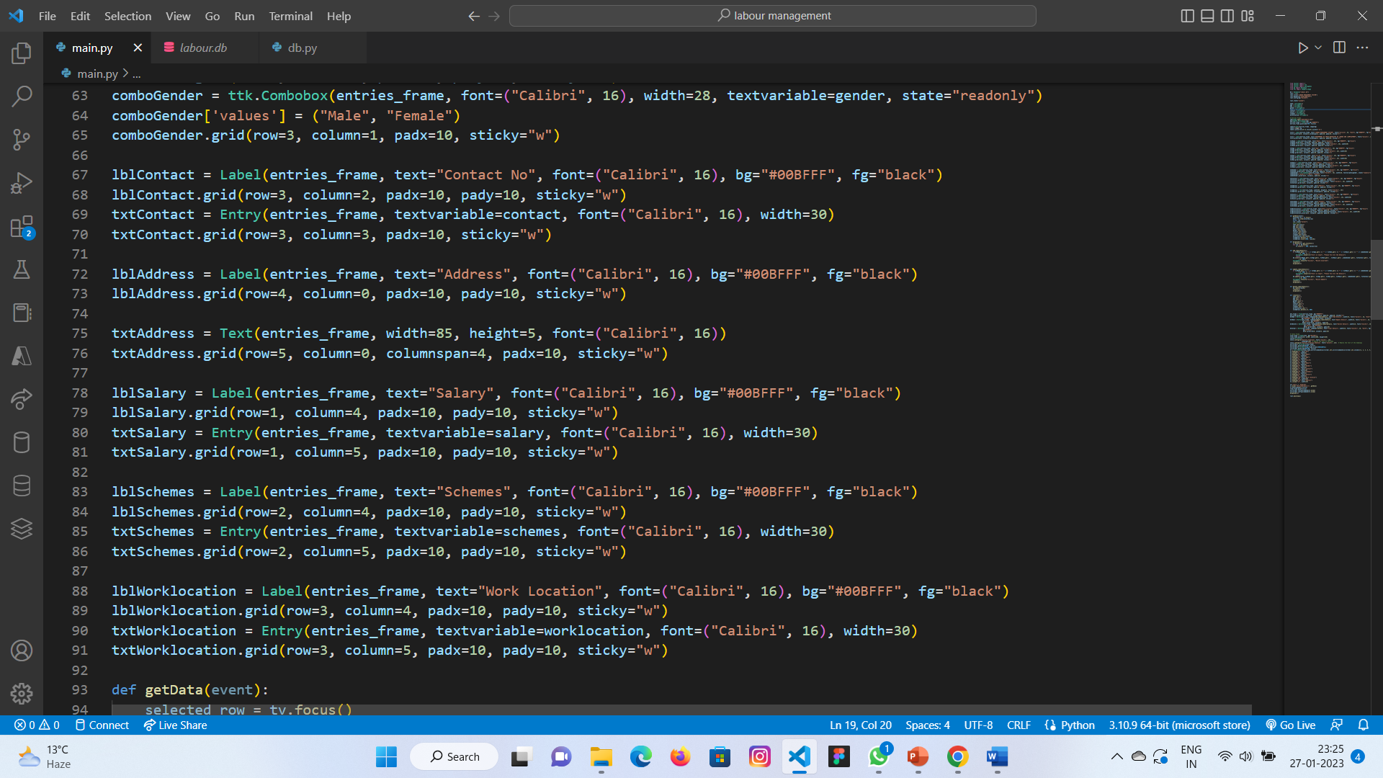
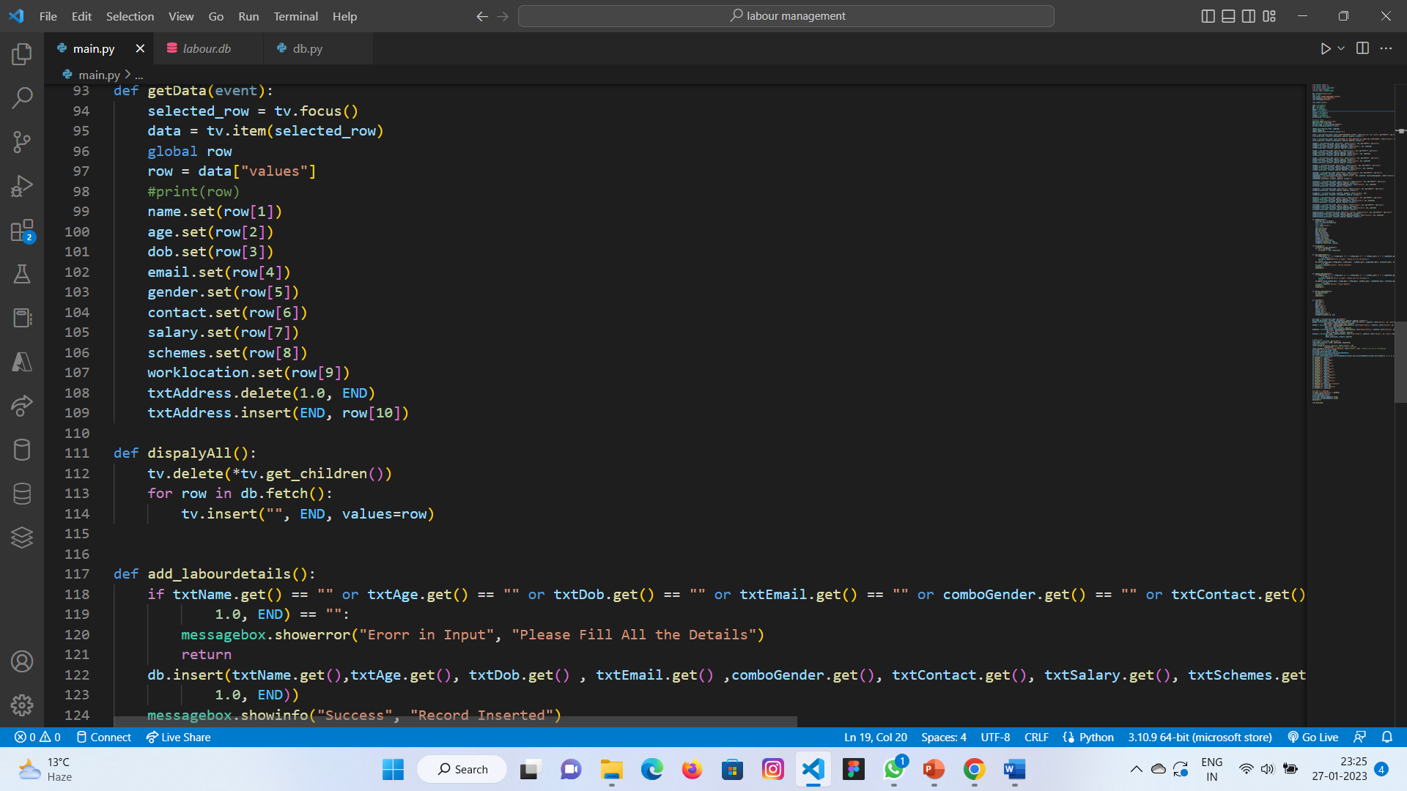
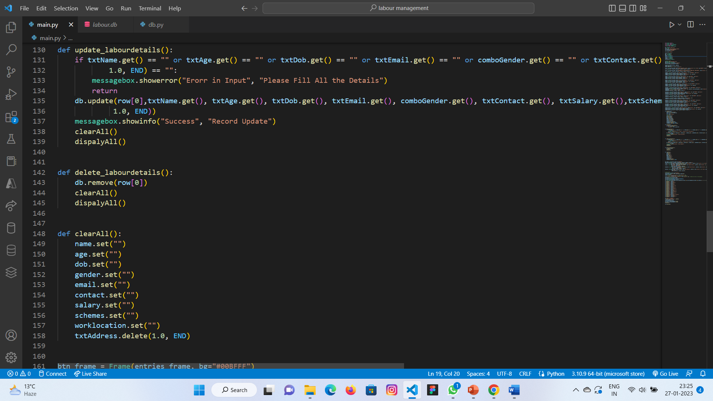
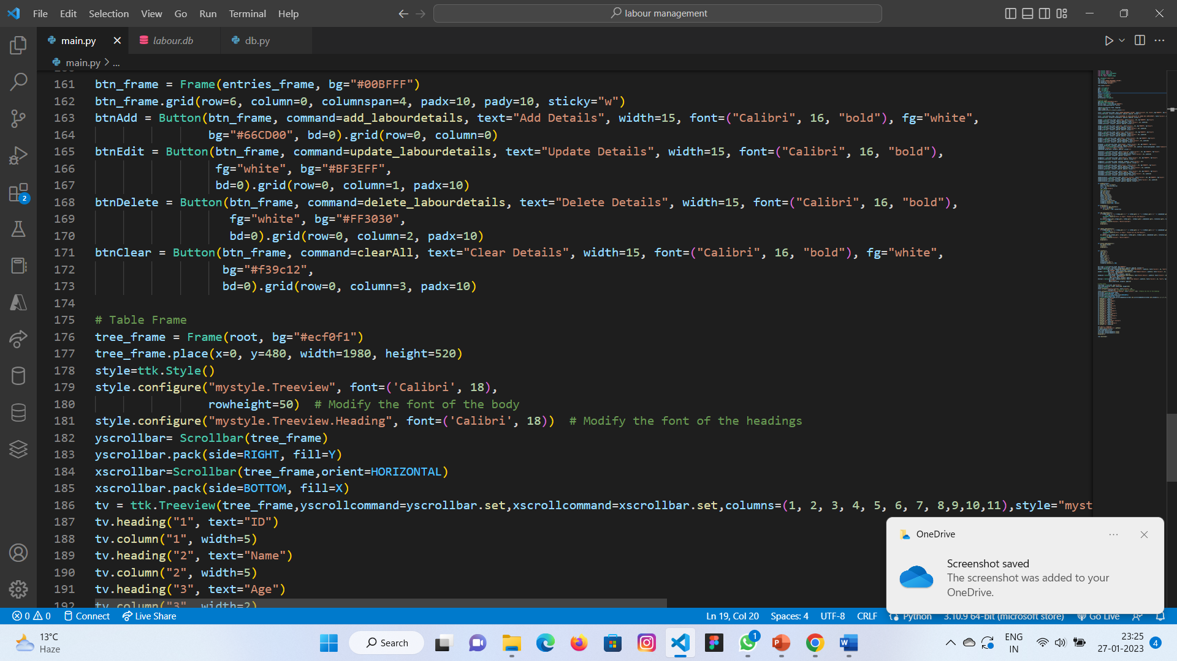
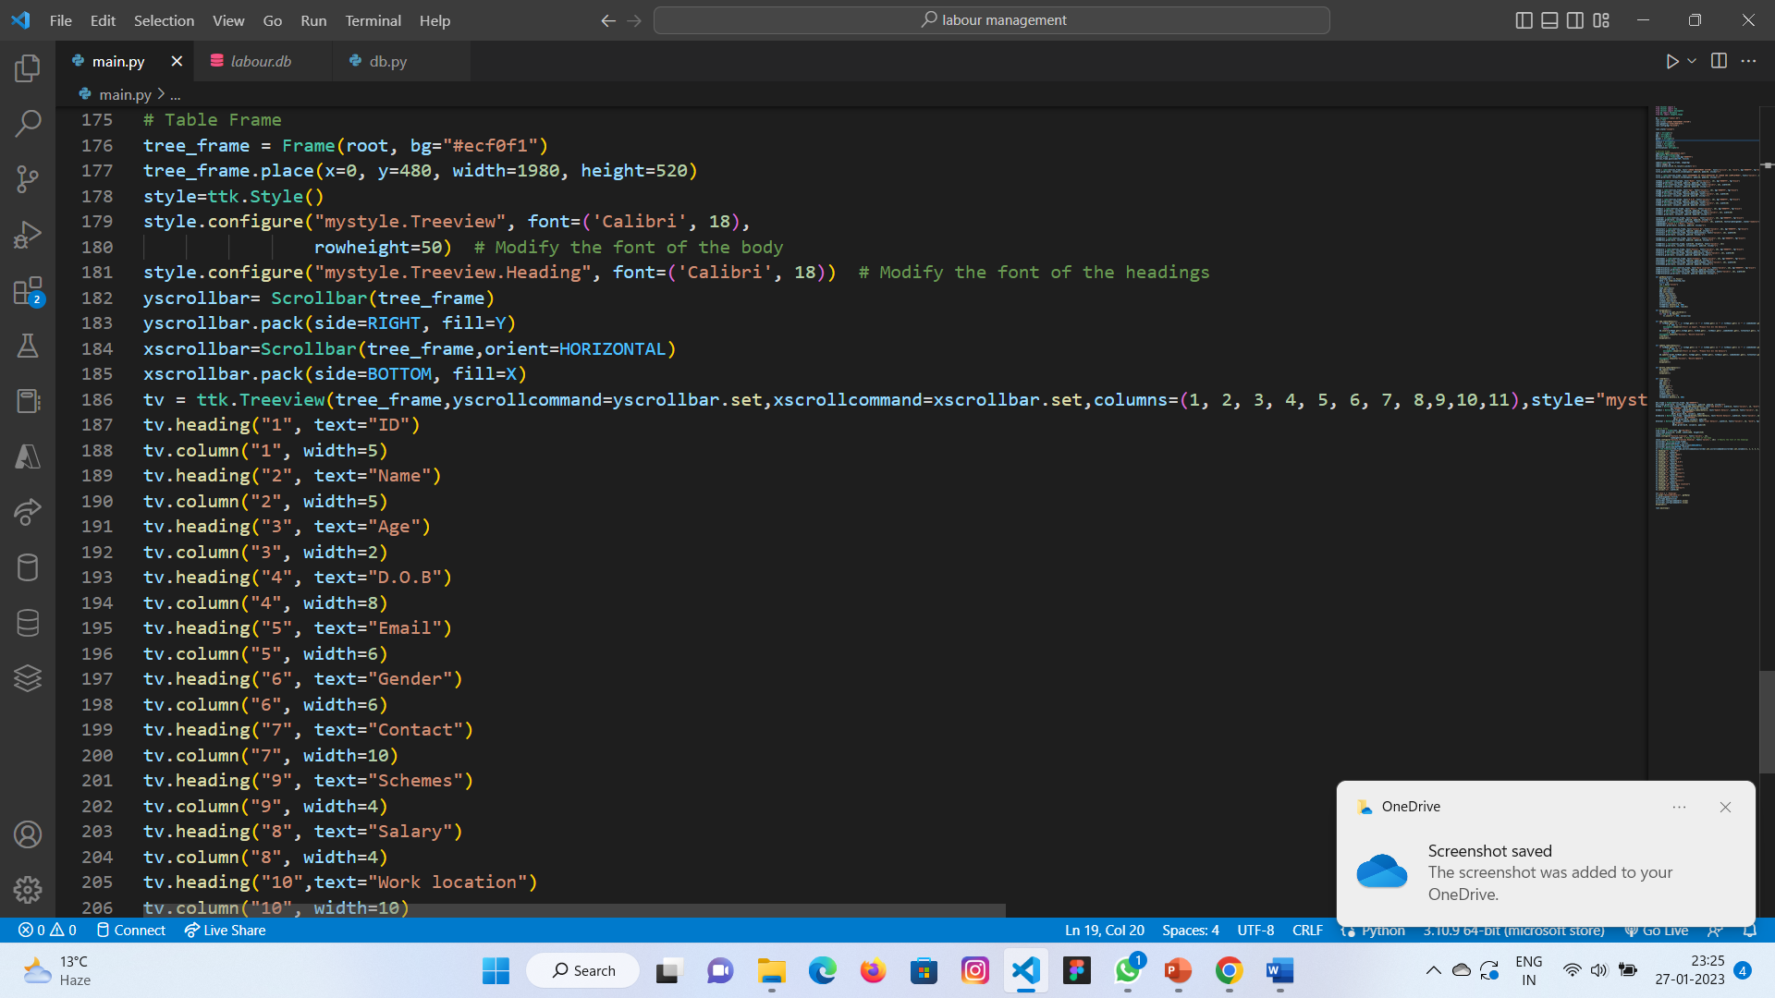
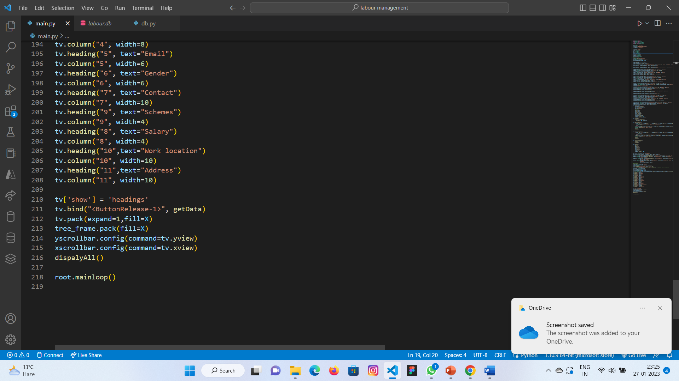
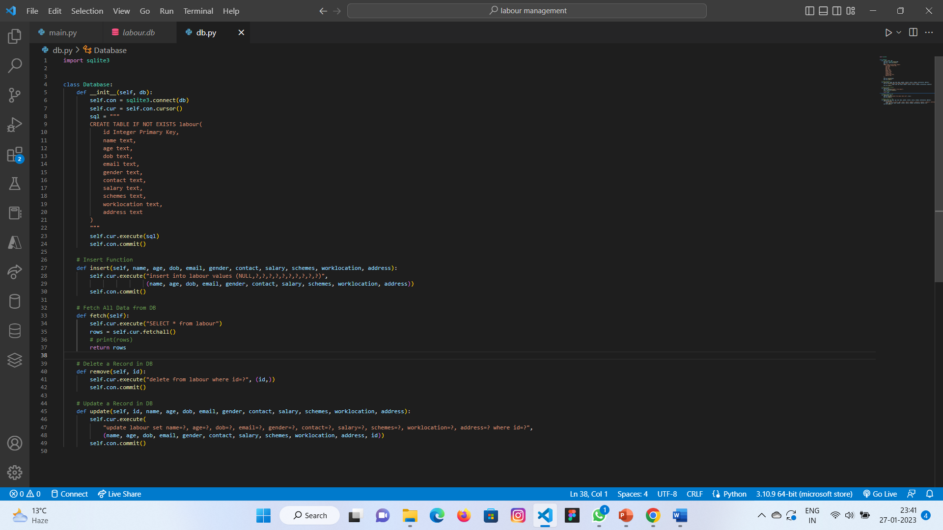

Slide 12
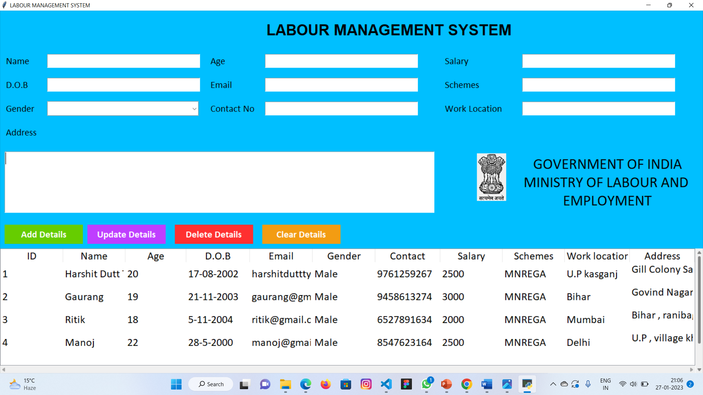
RESULT AND DISCUSSION

Slide 13
RESULT AND DISCUSSION

Slide 14
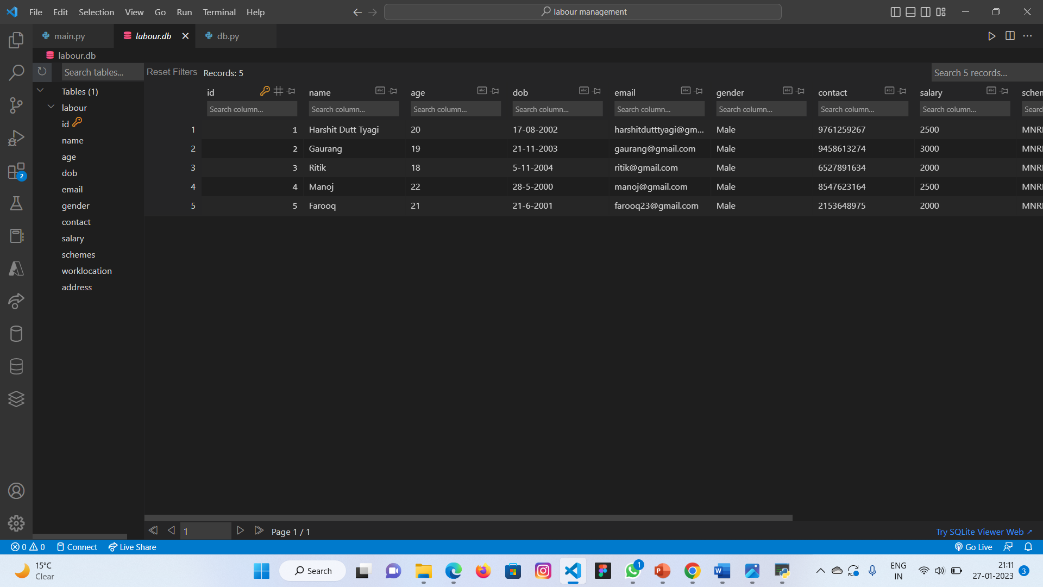
RESULT AND DISCUSSION

Slide 15
RESULT AND DISCUSSION

Slide 16
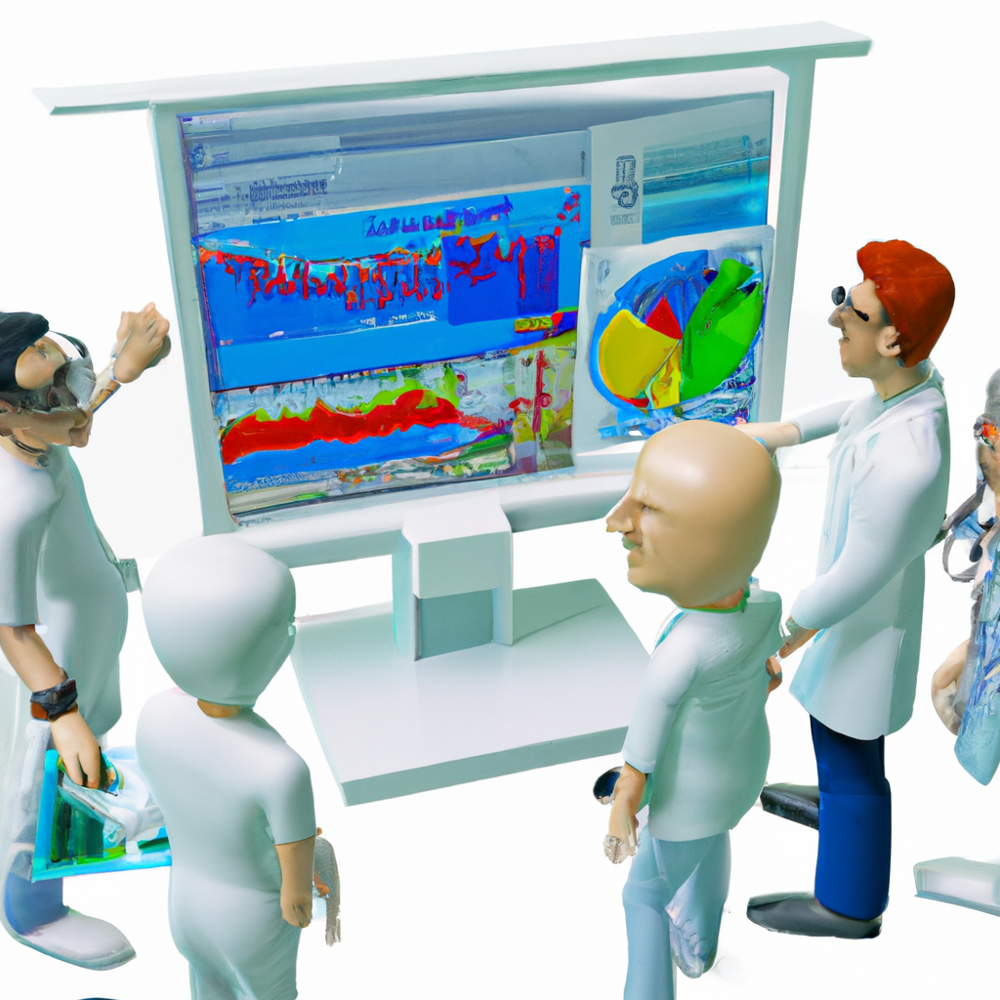
Artificial Intelligence and Machine Learning: These technologies can be used to automate repetitive tasks and improve the efficiency of labor management systems
Mobile and Remote Access: As more people work remotely, labor management systems will need to be accessible from mobile devices and the internet, so employees can access them from anywhere
Compliance and Regulations: There will be an increased focus on compliance with labor laws and regulations, so future labor management systems will need to be able to help employers stay compliant
Human-centered design: There will be an increased focus on the user experience of labor management systems and how they can be designed to better suit the needs of employees and managers.
Predictive Analytics: Predictive analytics can be used to forecast labor needs, identify potential issues, and take proactive measures to avoid them.Cloud-Based Systems: Cloud-based systems can make it easier for managers to access labor management information and collaborate with other stakeholders
CONCLUSION AND FUTURE WORK

Slide 17
CONCLUSION AND FUTURE WORK
Artificial Intelligence and Machine Learning: These technologies can be used to automate repetitive tasks and improve the efficiency of labor management systems
Mobile and Remote Access: As more people work remotely, labor management systems will need to be accessible from mobile devices and the internet, so employees can access them from anywhere
Compliance and Regulations: There will be an increased focus on compliance with labor laws and regulations, so future labor management systems will need to be able to help employers stay compliant
Human-centered design: There will be an increased focus on the user experience of labor management systems and how they can be designed to better suit the needs of employees and managers.
Predictive Analytics: Predictive analytics can be used to forecast labor needs, identify potential issues, and take proactive measures to avoid them.Cloud-Based Systems: Cloud-based systems can make it easier for managers to access labor management information and collaborate with other stakeholders

Slide 18
THANK YOU !

Slide 19
THANK YOU !

